Slide 1
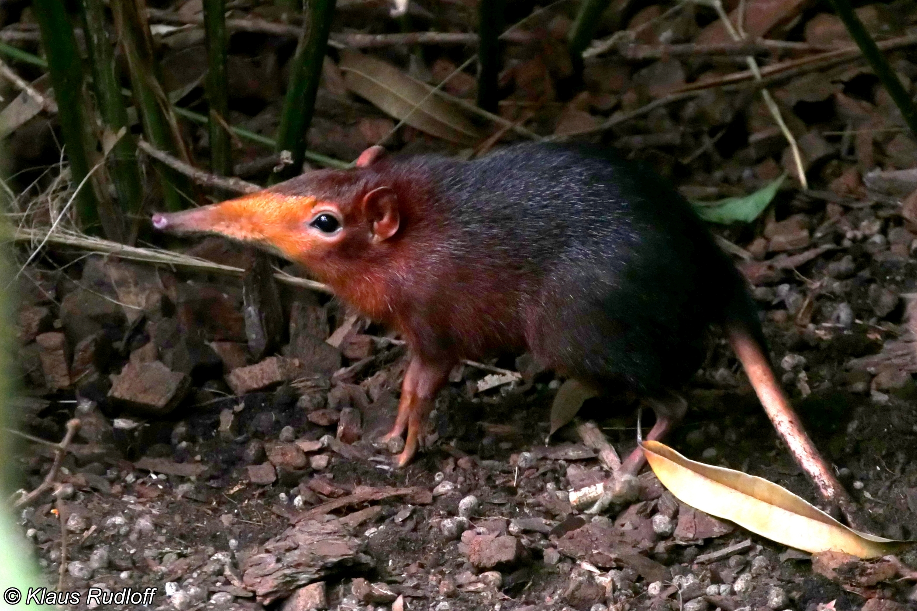
A better way to estimate population sizes

Slide 2
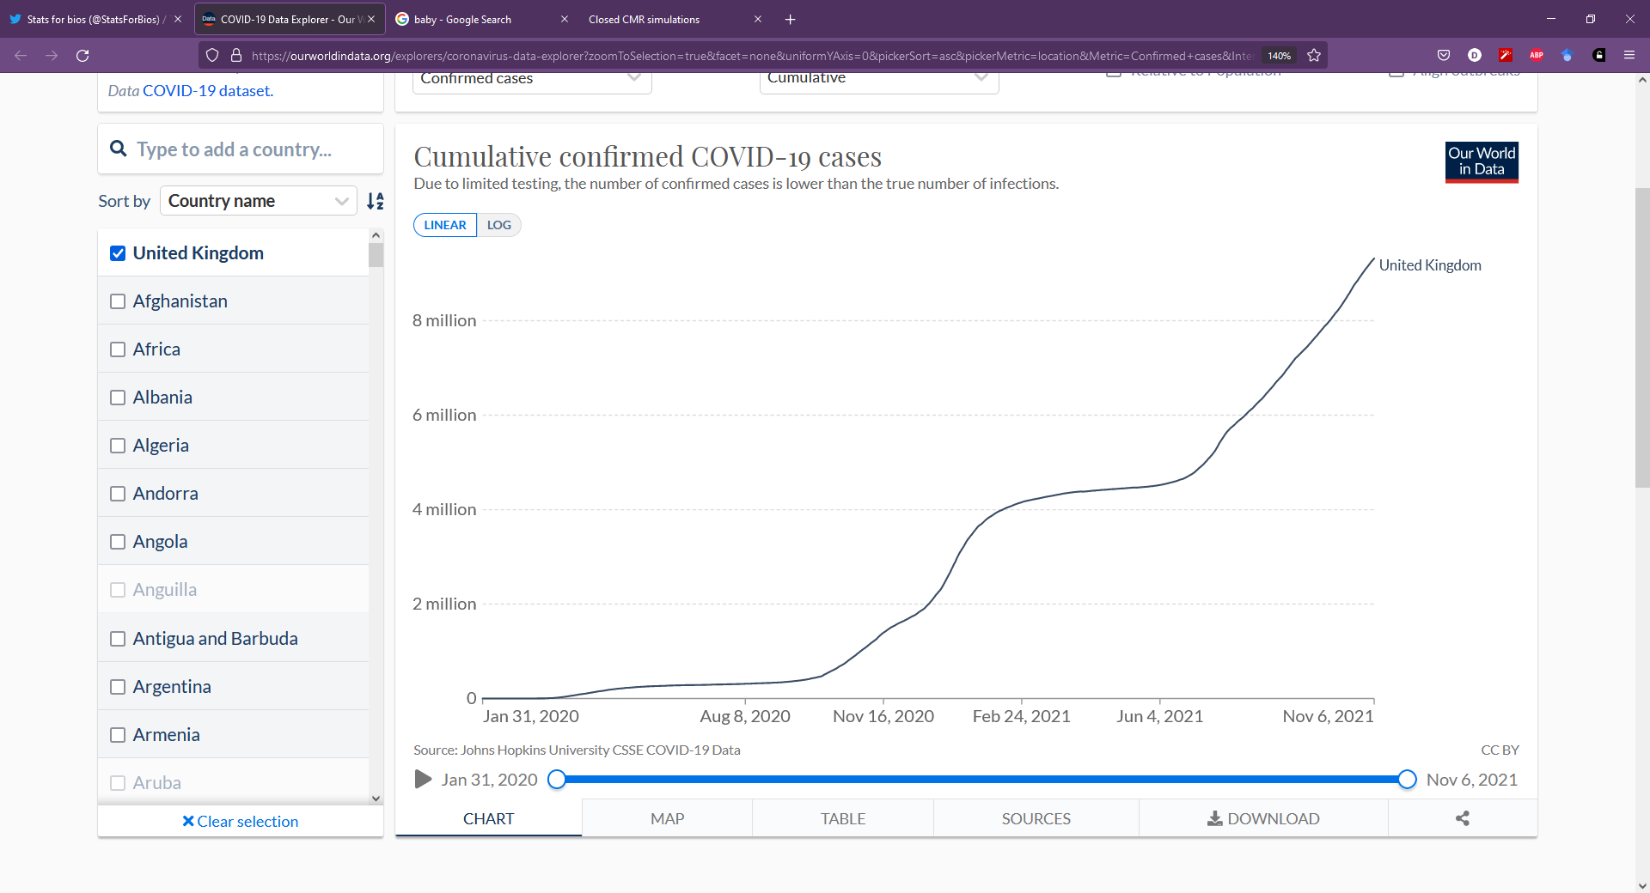
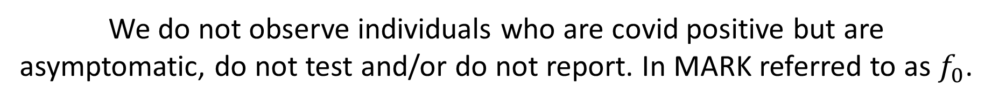
A tangent: Why is imperfect detection important?
Question:
How many covid cases have there been in the UK?
Answer:
Unknown, but almost certainly more than 9.32 million.
Why:
We only know how many people have tested positively, of those who tested and reported.
We do not observe individuals who are covid positive but are asymptomatic, do not test and/or do not report. In MARK referred to as $f_{0}$.

Slide 3

Wide variety of models available to estimate $\hat{N}$
Closed Population CMR models:
Lincoln-Peterson model (2 occasions)
Allows estimation of population size
But has restrictive model assumptions
General K-samples models (>2 occasions/samples)
Allows 3 key sources of variation in capture rate to be accounted for:
Time
Heterogeneity
Behaviour
Open Population CMR models:
Used to estimate individual survival rather than population size
More on this next week

Slide 4
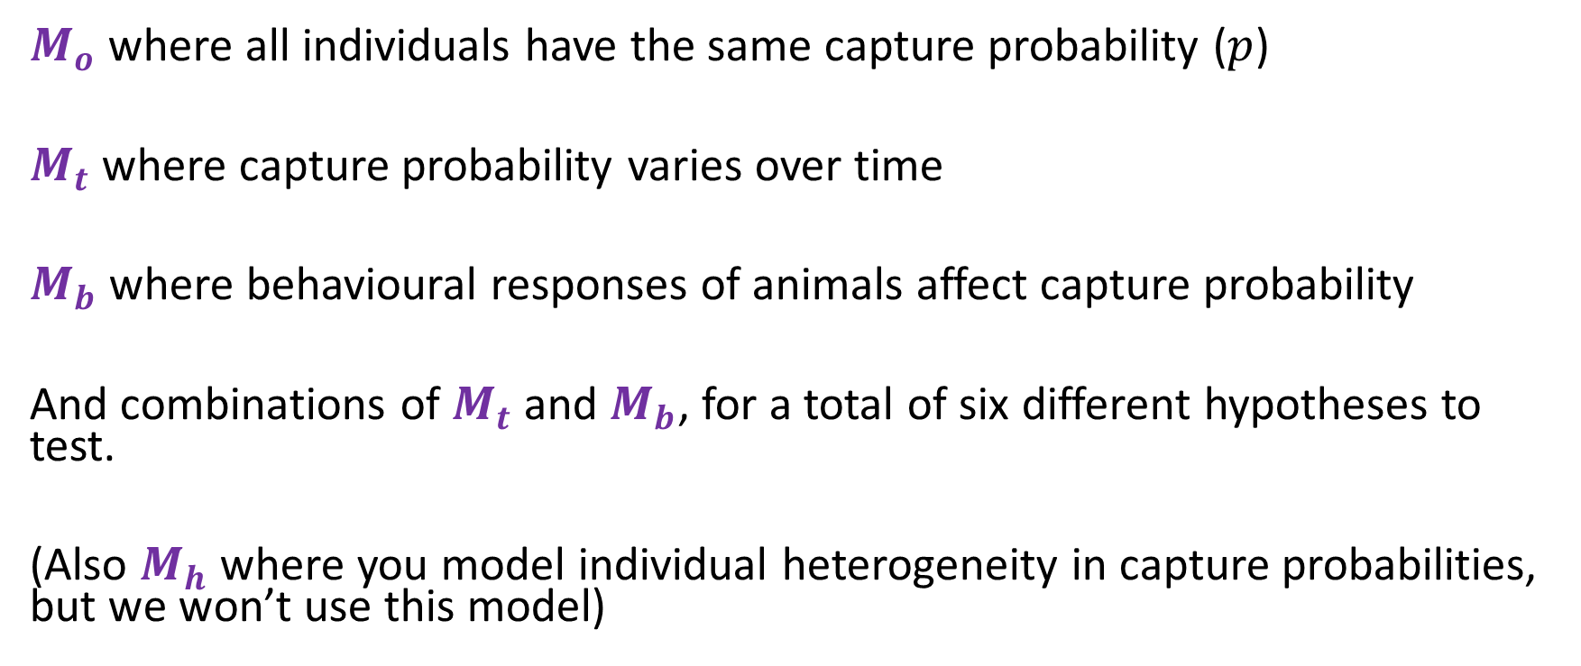
The Otis CMR models
$M_{o}$ where all individuals have the same capture probability ($p$)
$M_{t}$ where capture probability varies over time
$M_{b}$ where behavioural responses of animals affect capture probability
And combinations of $M_{t}$ and $M_{b}$, for a total of six different hypotheses to test.
(Also $M_{h}$ where you model individual heterogeneity in capture probabilities, but we won’t use this model)

Slide 5
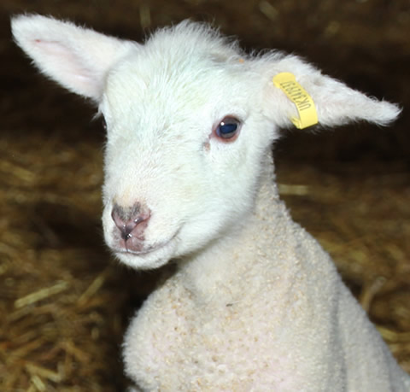
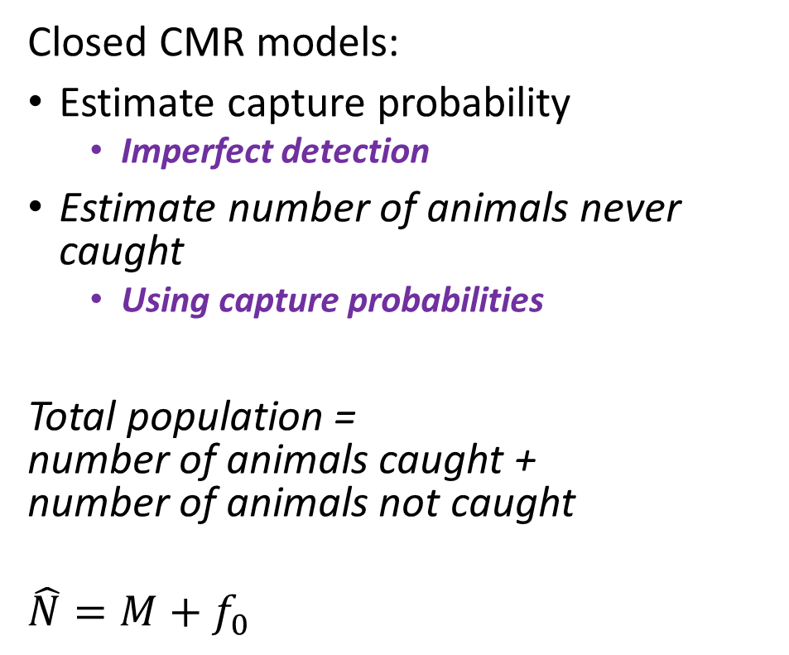
Closed capture-mark-recapture models
Closed CMR models:
Estimate capture probability
Imperfect detection
Estimate number of animals never caught
Using capture probabilities
Total population = number of animals caught + number of animals not caught
$$\hat{N}=M+f_{0}$$

Slide 6
Capture history of individuals
Lincoln-Peterson model only cares if any animal has been previously marked
But if we trap for > 2 occasions, we can take into account when individuals were caught.
Uniquely marking individuals allows us to build unique capture histories for each individual:
A capture history looks like: 1001
1001 means Sally was captured on 1st and 4th occasion, but not on the 2nd or 3rd
Same assumptions as Lincoln-Peterson except:
Capture probabilities (p) don’t have to be identical
Requires more than 1 recapture occasion (i.e., > 2 days of trapping)

Slide 7
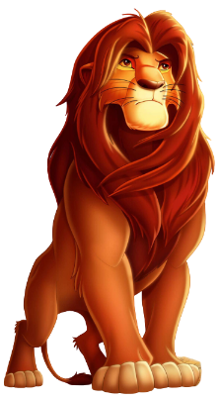
We’re still assuming a closed population
First survey
Time between surveys
Second survey
If a population is closed, we assume that there is a short time between surveys, where no reproduction or death occurs and no individuals enter or leave the site

Slide 8
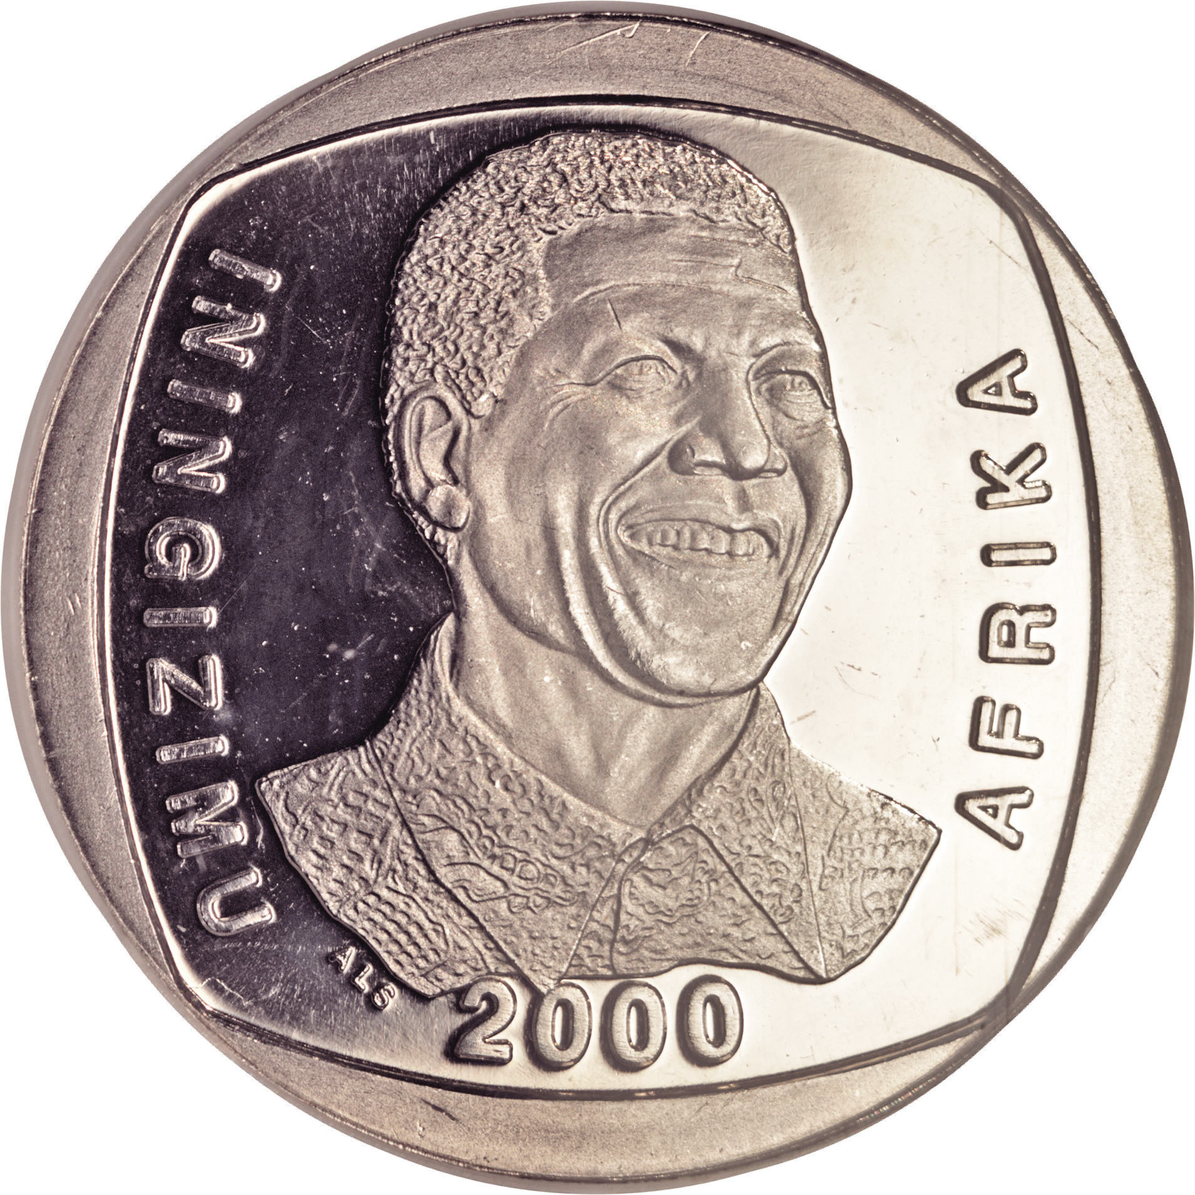
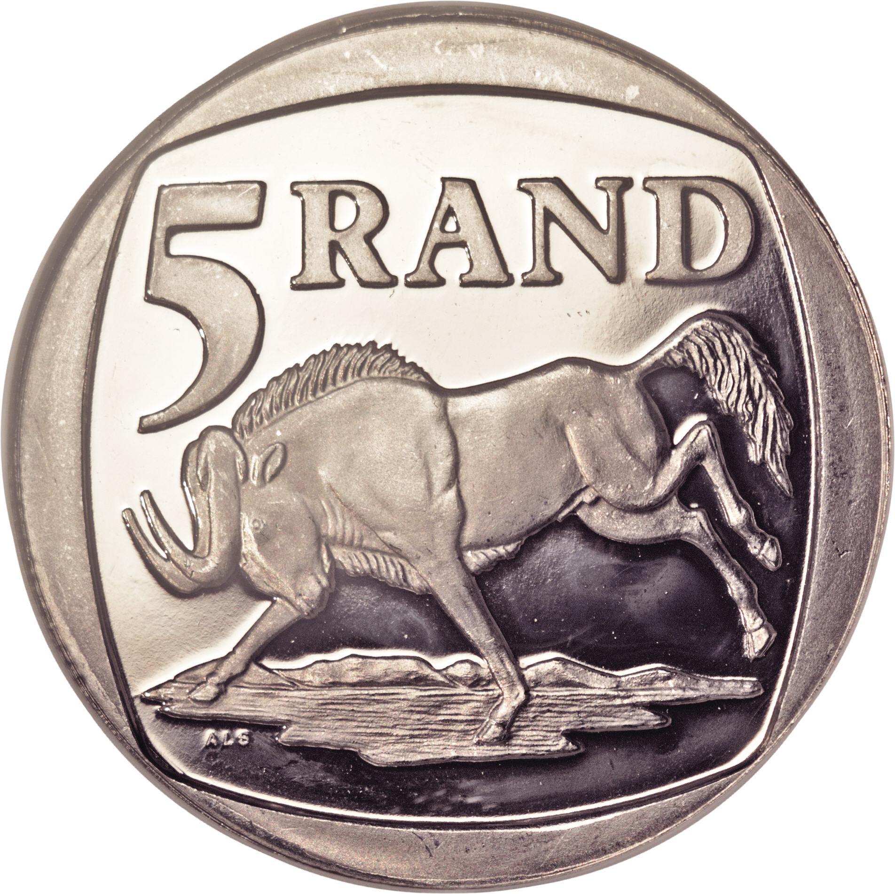
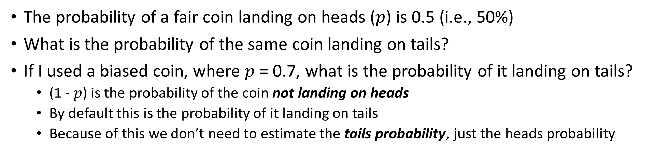
A tangent: a hustler tossing coins
The probability of a fair coin landing on heads ($p$) is 0.5 (i.e., 50%)
What is the probability of the same coin landing on tails?
If I used a biased coin, where $p$ = 0.7, what is the probability of it landing on tails?
(1 - $p$) is the probability of the coin not landing on heads
By default this is the probability of it landing on tails
Because of this we don’t need to estimate the tails probability, just the heads probability

Slide 9
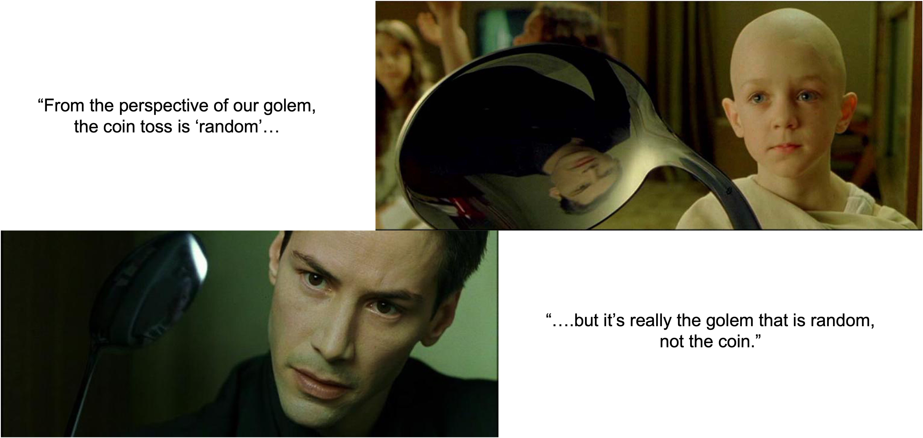
“From the perspective of our model, the coin toss is ‘random’…”
“…but it’s really the model that is random, not the coin.”

Slide 10
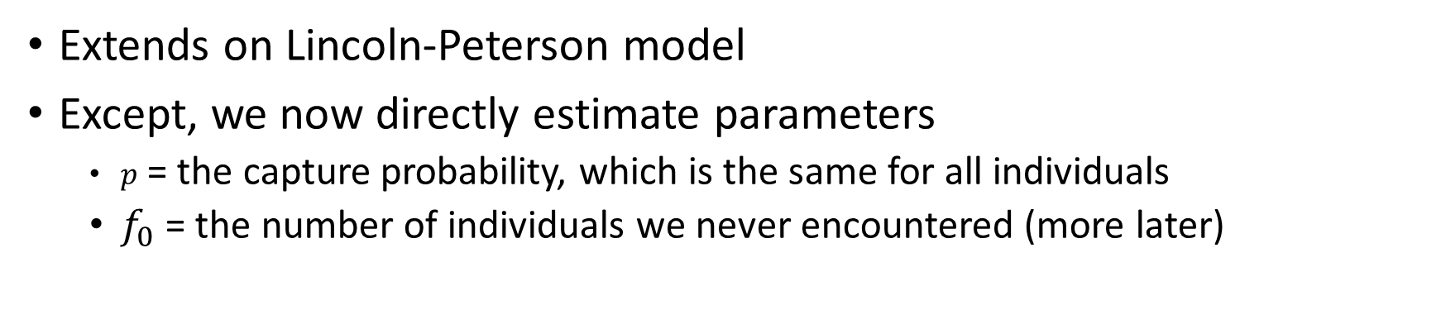
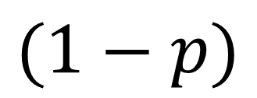
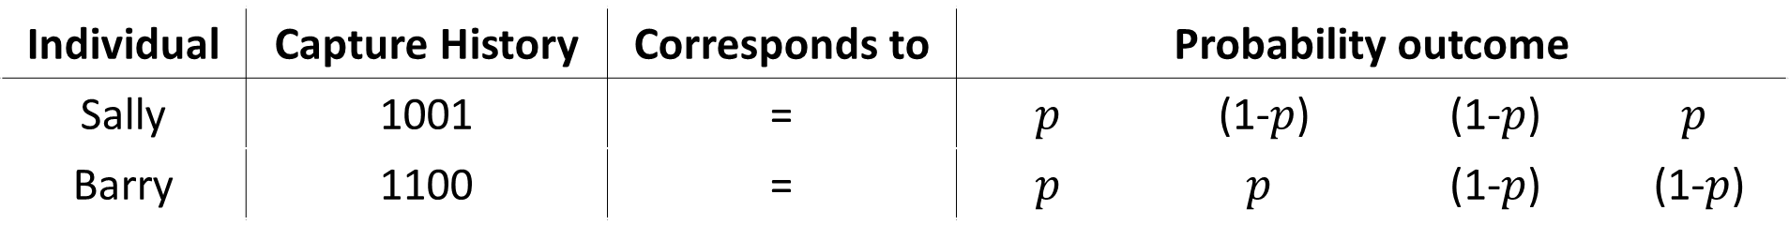
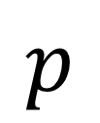
Equal capture model (or M_{o})
Extends on Lincoln-Peterson model
Except, we now directly estimate parameters
$p$ = the capture probability, which is the same for all individuals
$f_{0}$ = the number of individuals we never encountered (more later)
Individual | Capture History | Corresponds to | Probability outcome | Capture prob | Capture prob | Capture prob
Sally | 1001 | = | $$p$$ | (1-$p$) | (1-$p$) | $$p$$
Barry | 1100 | = | $$p$$ | $$p$$ | (1-$p$) | (1-$p$)
$$p$$
$$(1−p)$$

Slide 11
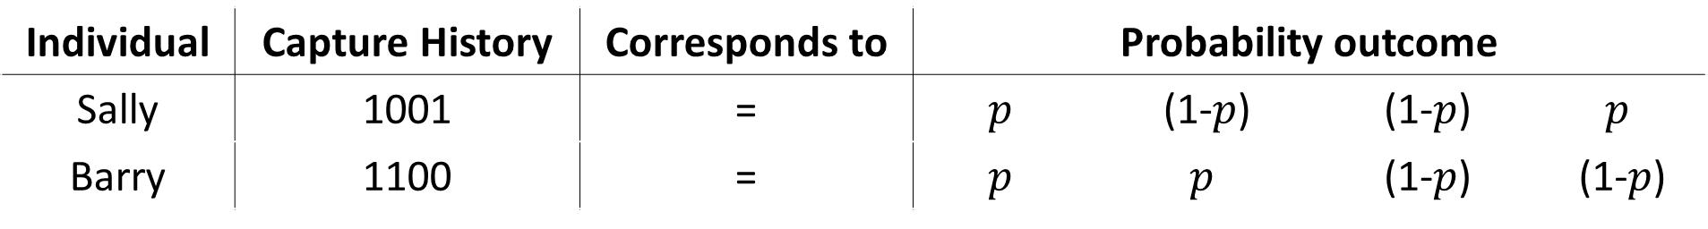
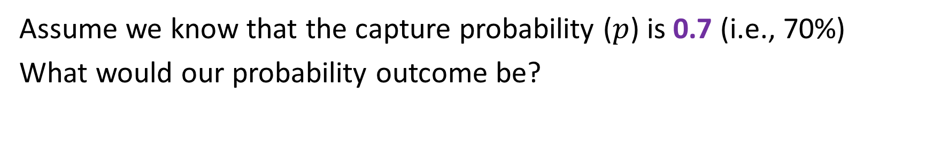
Equal capture model (or M_{o})
Assume we know that the capture probability ($p$) is 0.7 (i.e., 70%)
What would our probability outcome be?
Individual | Capture History | Corresponds to | Probability outcome | Capture prob | Capture prob | Capture prob
Sally | 1001 | = | $$p$$ | (1-$p$) | (1-$p$) | $$p$$
Barry | 1100 | = | $$p$$ | $$p$$ | (1-$p$) | (1-$p$)
Individual | Capture History | Corresponds to | Probability outcome | Capture prob | Capture prob | Capture prob
Sally | 1001 | = | 0.7 | 0.3 | 0.3 | 0.7
Barry | 1100 | = | 0.7 | 0.7 | 0.3 | 0.3

Slide 12
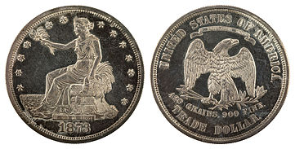
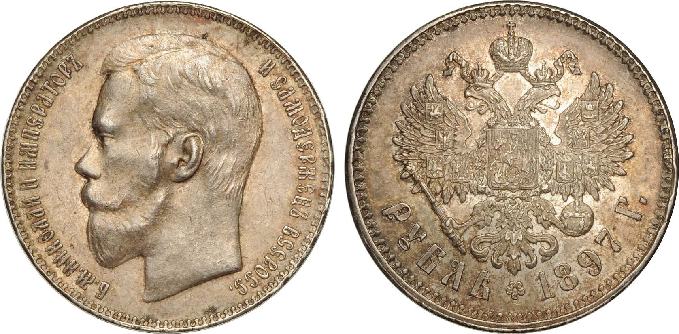
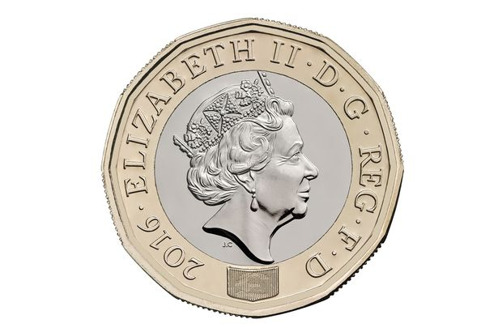
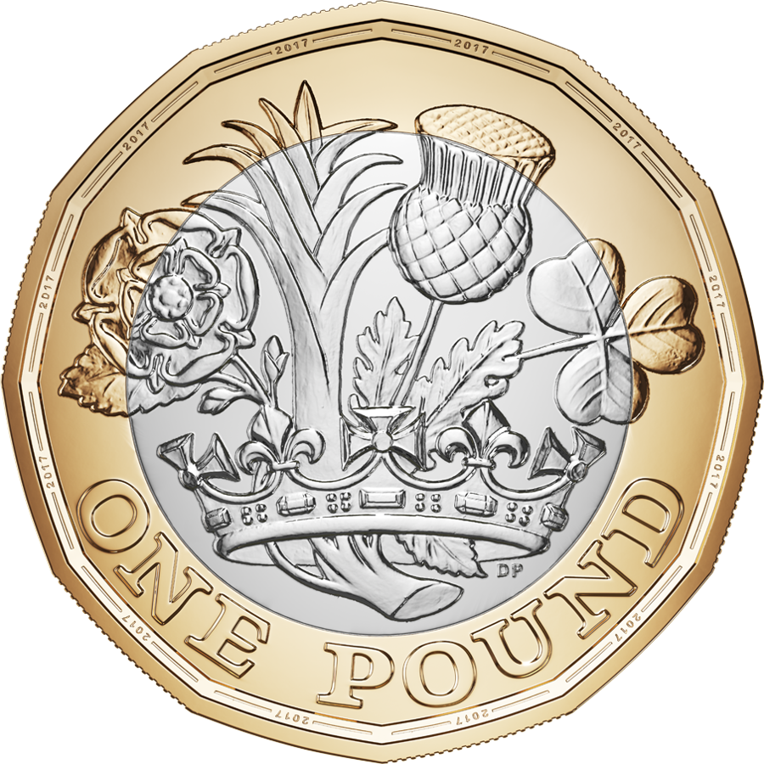
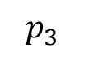
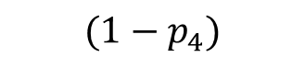
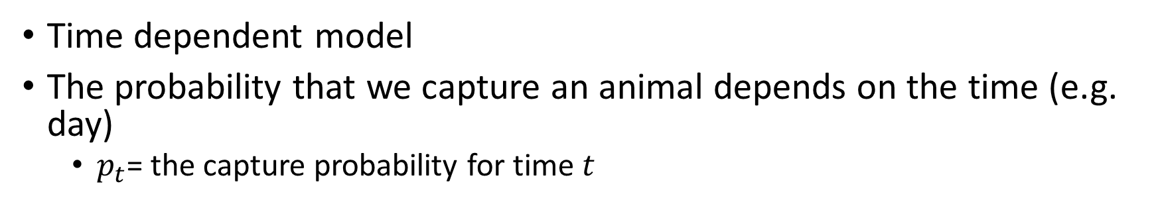
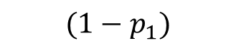
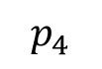

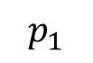
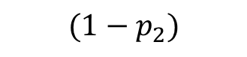
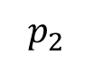
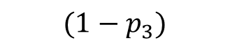
Time dependent model (or M_{t})
Time dependent model
The probability that we capture an animal depends on the time (e.g. day)
$p_{t}$= the capture probability for time $t$
Individual | Capture History | Corresponds to | Probability outcome | Capture prob | Capture prob | Capture prob
Sally | 1001 | = | $$p_{1}$$ | (1-$p_{2}$) | (1-$p_{3}$) | $$p_{4}$$
Barry | 1100 | = | $$p_{1}$$ | $$p_{2}$$ | (1-$p_{3}$) | (1-$p_{4}$)
$$p_{1}$$
$$(1−p_{1})$$
$$p_{2}$$
$$(1−p_{2})$$
$$p_{3}$$
$$(1−p_{3})$$
$$p_{4}$$
$$(1−p_{4})$$

Slide 13
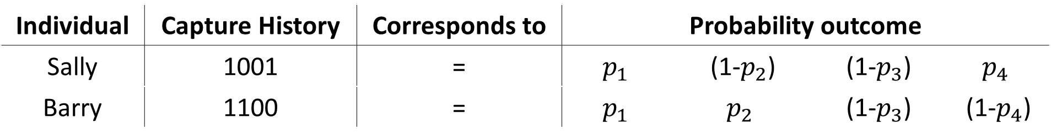
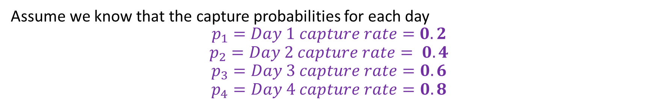
Time dependent model (or M_{t})
Assume we know that the capture probabilities for each day
$$p_{1}=Day 1 capture rate=0.2$$
$$p_{2}=Day 2 capture rate= 0.4$$
$$p_{3}=Day 3 capture rate=0.6$$
$$p_{4}=Day 4 capture rate=0.8$$
Individual | Capture History | Corresponds to | Probability outcome | Capture prob | Capture prob | Capture prob
Sally | 1001 | = | $$p_{1}$$ | (1-$p_{2}$) | (1-$p_{3}$) | $$p_{4}$$
Barry | 1100 | = | $$p_{1}$$ | $$p_{2}$$ | (1-$p_{3}$) | (1-$p_{4}$)
Individual | Capture History | Corresponds to | Probability outcome | Capture prob | Capture prob | Capture prob
Sally | 1001 | = | 0.2 | 0.6 | 0.4 | 0.8
Barry | 1100 | = | 0.2 | 0.4 | 0.4 | 0.2

Slide 14
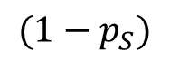
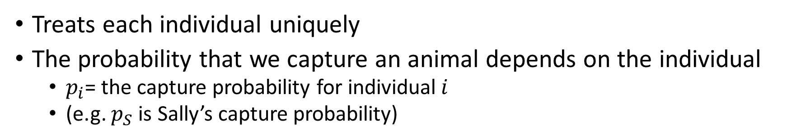
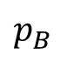

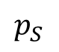
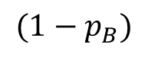
Heterogeneity model (or M_{h})
Treats each individual uniquely
The probability that we capture an animal depends on the individual
$p_{i}$= the capture probability for individual$i$
(e.g. $p_{S}$ is Sally’s capture probability)
Individual | Capture History | Corresponds to | Probability outcome | Capture prob | Capture prob | Capture prob
Sally | 1001 | = | $$p_{S}$$ | (1-$p_{S}$) | (1-$p_{S}$) | $$p_{S}$$
Barry | 1100 | = | $$p_{B}$$ | $$p_{B}$$ | (1-$p_{B}$) | (1-$p_{B}$)
$$p_{S}$$
$${(1−p}_{S})$$
$$p_{B}$$
$${(1−p}_{B})$$

Slide 15

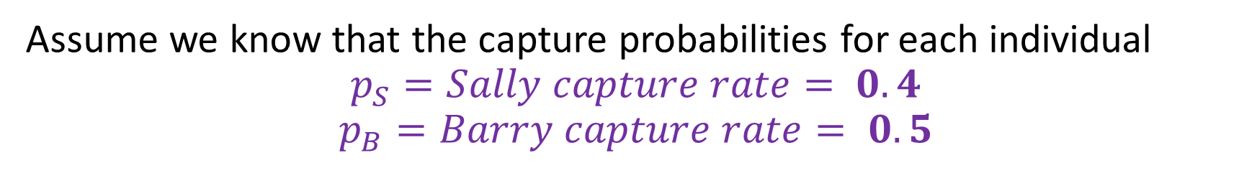
Heterogeneity model (or M_{h})
Assume we know that the capture probabilities for each individual
$$p_{S}=Sally capture rate= 0.4$$
$$p_{B}=Barry capture rate= 0.5$$
Individual | Capture History | Corresponds to | Probability outcome | Capture prob | Capture prob | Capture prob
Sally | 1001 | = | $$p_{S}$$ | (1-$p_{S}$) | (1-$p_{S}$) | $$p_{S}$$
Barry | 1100 | = | $$p_{B}$$ | $$p_{B}$$ | (1-$p_{B}$) | (1-$p_{B}$)
Individual | Capture History | Corresponds to | Probability outcome | Capture prob | Capture prob | Capture prob
Sally | 1001 | = | 0.4 | 0.6 | 0.6 | 0.4
Barry | 1100 | = | 0.5 | 0.5 | 0.5 | 0.5

Slide 16
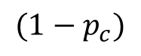
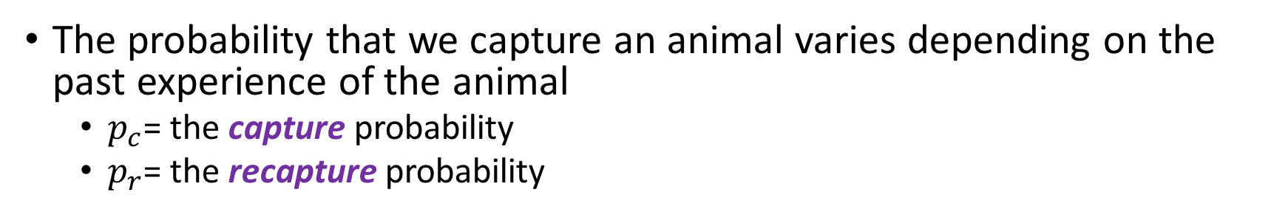
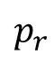
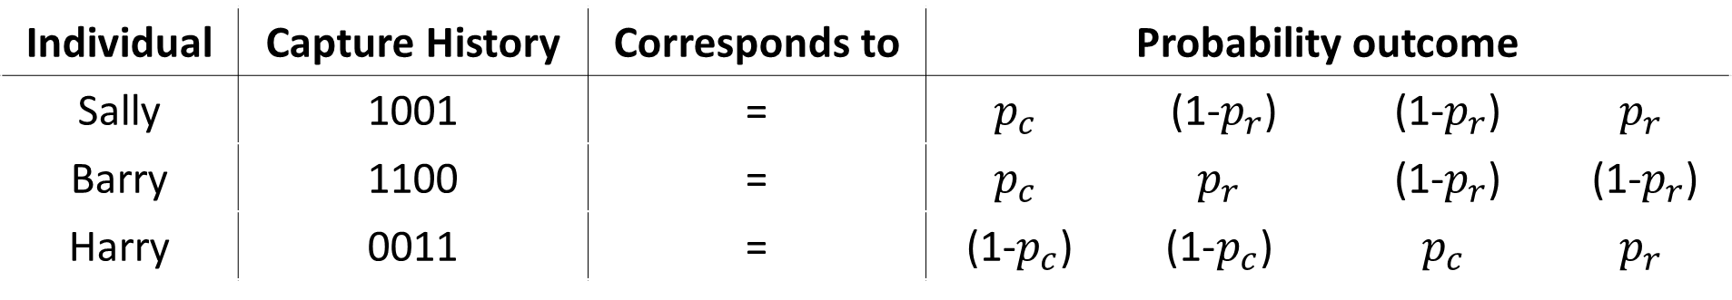
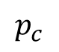
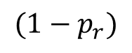
Behavioural model (or M_{b})
The probability that we capture an animal varies depending on the past experience of the animal
$p_{c}$= the capture probability
$p_{r}$= the recapture probability
Individual | Capture History | Corresponds to | Probability outcome | Capture prob | Capture prob | Capture prob
Sally | 1001 | = | $$p_{c}$$ | (1-$p_{r}$) | (1-$p_{r}$) | $$p_{r}$$
Barry | 1100 | = | $$p_{c}$$ | $$p_{r}$$ | (1-$p_{r}$) | (1-$p_{r}$)
Harry | 0011 | = | (1-$p_{c}$) | $$\text{(1−}p_{c}\text{)}$$ | $$p_{c}$$ | $$p_{r}$$
$$p_{c}$$
$${(1−p}_{c})$$
$$p_{r}$$
$${(1−p}_{r})$$

Slide 17

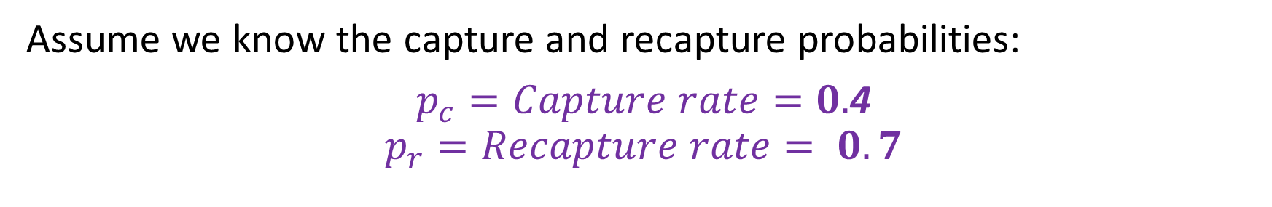
Behavioural model (or M_{b})
Assume we know the capture and recapture probabilities:
$p_{c}=Capture rate=0.$4
$$p_{r}=Recapture rate= 0.7$$
Individual | Capture History | Corresponds to | Probability outcome | Capture prob | Capture prob | Capture prob
Sally | 1001 | = | $$p_{c}$$ | (1-$p_{r}$) | (1-$p_{r}$) | $$p_{r}$$
Barry | 1100 | = | $$p_{c}$$ | $$p_{r}$$ | (1-$p_{r}$) | (1-$p_{r}$)
Harry | 0011 | = | (1-$p_{c}$) | $$\text{(1−}p_{c}\text{)}$$ | $$p_{c}$$ | $$p_{r}$$
Individual | Capture History | Corresponds to | Probability outcome | Capture prob | Capture prob | Capture prob
Sally | 1001 | = | 0.4 | 0.3 | 0.3 | 0.7
Barry | 1100 | = | 0.4 | 0.7 | 0.3 | 0.3
Harry | 0011 | = | 0.6 | 0.6 | 0.4 | 0.6

Slide 18
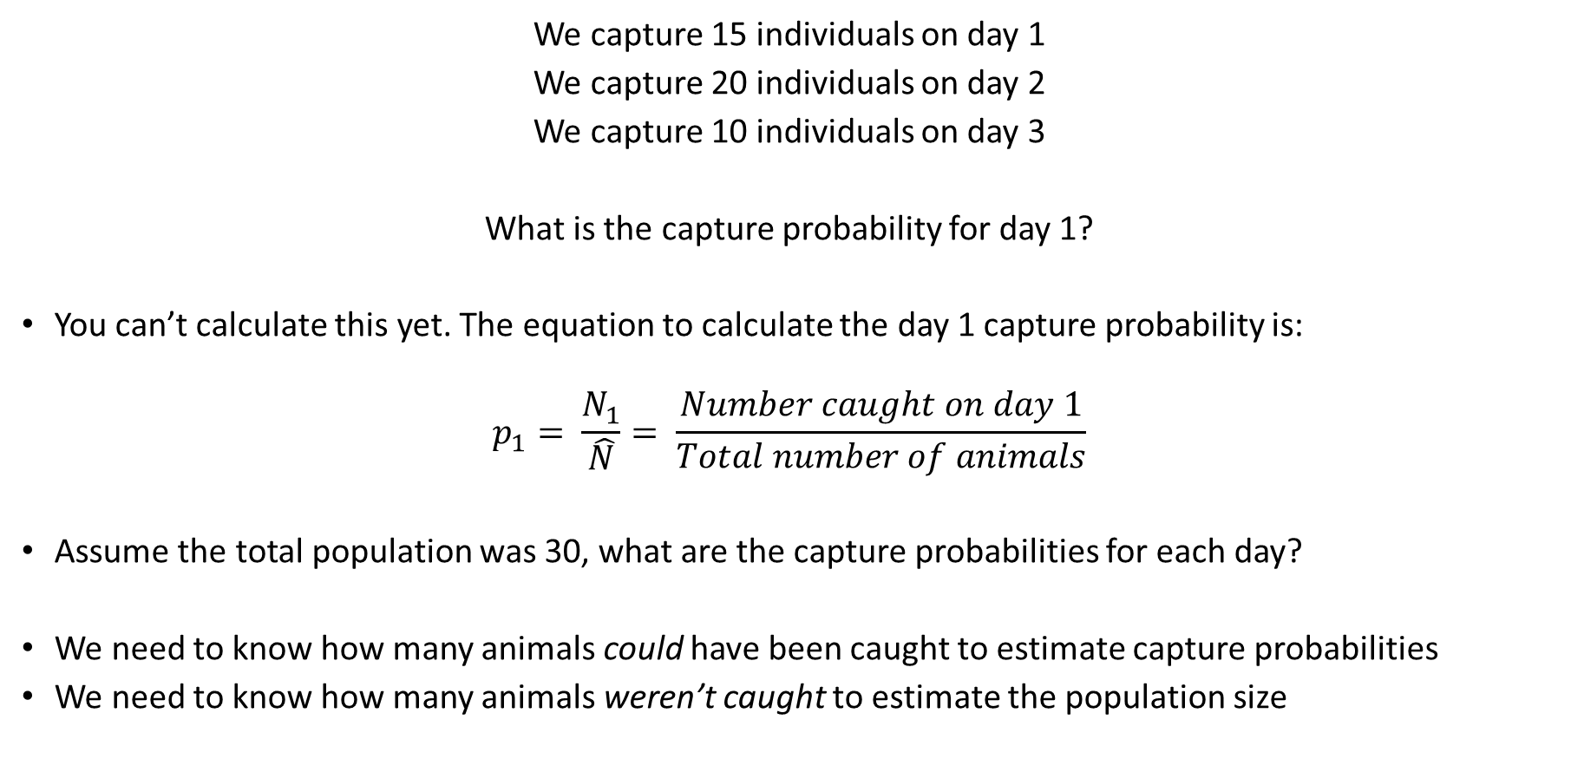
Capture probability by hand
We capture 15 individuals on day 1
We capture 20 individuals on day 2
We capture 10 individuals on day 3
What is the capture probability for day 1?
You can’t calculate this yet. The equation to calculate the day 1 capture probability is:
$$p_{1}= \frac{N_{1}}{\hat{N}}= \frac{Number caught on day 1}{Total number of animals}$$
Assume the total population was 30, what are the capture probabilities for each day?
We need to know how many animals could have been caught to estimate capture probabilities
We need to know how many animals weren’t caught to estimate the population size

Slide 19
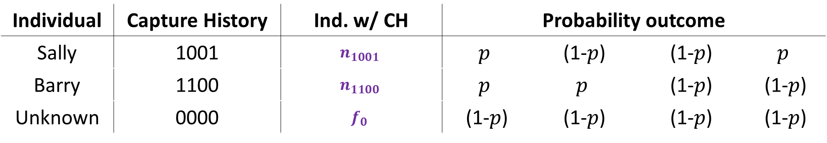
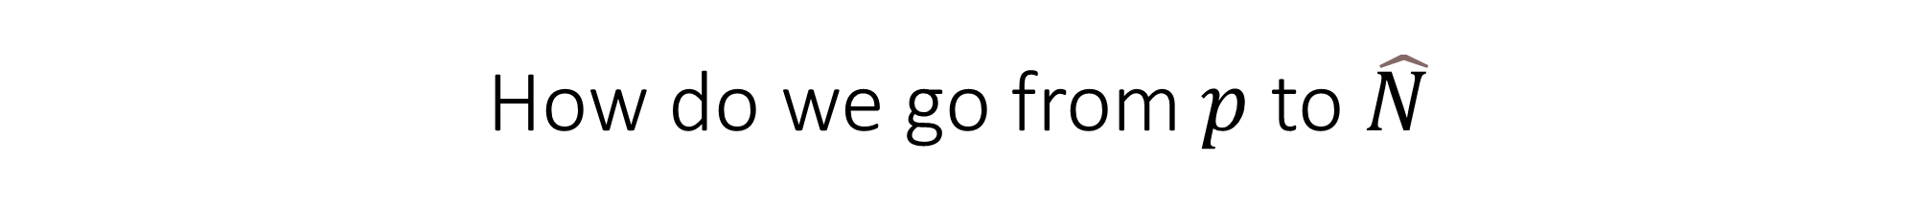
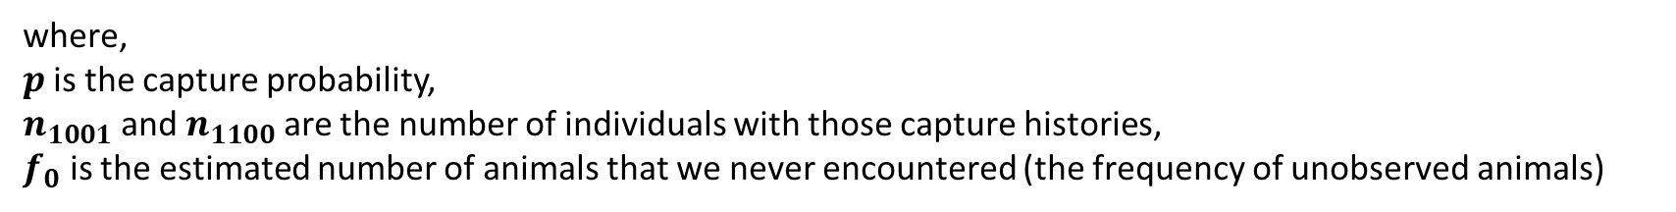
How do we go from $p$ to $\hat{N}$
Let’s work with the equal capture model
Individual | Capture History | Ind. w/ CH | Probability outcome | Capture prob | Capture prob | Capture prob
Sally | 1001 | $$n_{1001}$$ | $$p$$ | (1-$p$) | (1-$p$) | $$p$$
Barry | 1100 | $$n_{1100}$$ | $$p$$ | $$p$$ | (1-$p$) | (1-$p$)
Unknown | 0000 | $$f_{0}$$ | (1-$p$) | (1-$p$) | (1-$p$) | (1-$p$)
What we are asking the model to solve
The observed data
The two parameters we need to estimate
where,
$p$ is the capture probability,
$n_{1001}$ and $n_{1100}$ are the number of individuals with those capture histories,
$f_{0}$ is the estimated number of animals that we never encountered (the frequency of unobserved animals)

Slide 20
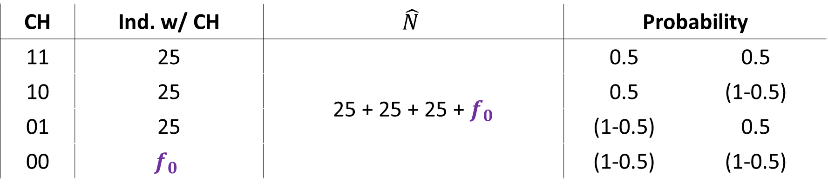

How do we estimate $f_{0}$?
Imagine we do trapping for 2 days
Note that we are “blind” to the 00 CH
CH | Ind. w/ CH | $$\hat{N}$$ | Probability | Capture prob
11 | 25 | 25 + 25 + 25 + $f_{0}$ | 0.5 | 0.5
10 | 25 |  | 0.5 | (1-0.5)
01 | 25 |  | (1-0.5) | 0.5
00 | $$f_{0}$$ | 29 + 29 + 29 + $f_{0}$ | (1-0.5) | (1-0.5)

Slide 21



How do we estimate $f_{0}$?
Capture History | Ind. w/ CH | Probability
11 | 25 | $$\left(M+f_{0}\right)×0.5×0.5$$
10 | 25 | $$\left(M+f_{0}\right)×0.5×(1−0.5)$$
01 | 25 | $$\left(M+f_{0}\right)×(1−0.5)×0.5$$
00 | $$f_{0}$$ | $\left(M+f_{0}\right)$ $×(1−0.5×(1−0.5)$
where,
$M$ is the total number of unique animals caught (i.e. 25 + 25 + 25 in this example),
$f_{0}$ is the estimated number of animals that we never encountered,
therefore, $M+f_{0}$ = $\hat{N}$

Slide 22


Rating values by “eye”
Let’s try assuming $f_{0}$ is 10 (i.e. we failed to encounter 10 animals)
Capture History | $n_{CH}$ | Probability | Expected $n_{CH}$
11 | 25 | $$\left(75+10\right)×0.5×0.5=$$ | 21.25
10 | 25 | $$\left(75+10\right)×0.5×\left(1−0.5\right)=$$ | 21.25
01 | 25 | $\left(75+10\right)$ $×\left(1−0.5\right)×0.5=$ | 21.25
How about assuming $f_{0}$ is 30
Capture History | $n_{CH}$ | Probability | Expected $n_{CH}$
11 | 25 | $$\left(75+30\right)×0.5×0.5=$$ | 26.25
10 | 25 | $$\left(75+30\right)×0.5×\left(1−0.5\right)=$$ | 26.25
01 | 25 | $\left(75+30\right)$ $×\left(1−0.5\right)×0.5=$ | 26.25

Slide 23


What does MLE suggest?
Maximum likelihood estimate will try a variety of values for $f_{0}$, each time judging how well that value work with the data.
It will rate each value of $f_{0}$, and report the most likely value back to us.
Assume it reports an $f_{0}=25.3$
$\hat{N}$ = $M+f_{0}=75+25.3=100.3$
Round up to $\hat{N}$ = 101 animals

Slide 24






Using MLE to estimate parameters
MLE estimates all parameters;
$p$ = the capture probability
For however many different capture probabilities we have, e.g.,
$p_{S}=Sally capture rate$
$p_{B}=Barry capture rate$
$p_{H}=Harry capture rate$
$f_{0}$ = the number of individuals we never encountered
MLE needs to find a combination of values for all parameters that works best with the observed data
$$p_{S}$$
$$p_{H}$$
$$p_{B}$$
$$f_{0}$$

Slide 25

tl;dr
We extend from Lincoln-Petersen to more sophisticated K-samples models
Allows us to vary the probability of capture ($p$), so it does not need to be constant
Animals “flip biased coins to decide if they will be caught”
We need to know how many animals we never caught to estimate what $p$ is
At the same time, to estimate how many animals we never caught we need to know the capture probability
$f_{0}$ is the parameter for the number never caught
Maximum Likelihood Estimation does the actual work, we just describe how we think we world might work (i.e., what was the process that determined if an animal entered our trap).

